Slide 1
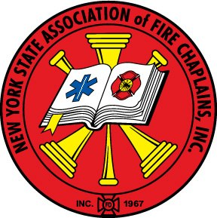
What to Save in a House of Worship Fire
Presented by
New York State Association
of Fire Chaplains, Inc.
© 2005/2017 New York State Association of Fire Chaplains, Inc.
Written by Past Chief Chaplain Kenneth Hessel 2014-2016

Slide 2
Objectives
The learner will be able to . . .
Identify the leading causes of House of Worship fires.
Recognize different styles of Houses of Worship.
Restate what possessions to try to save in a House of Worship fire.

Slide 3
Boston, MA January 18, 2005
A fire tore through the Church severely damaging the pre-Civil War landmark.

Slide 4
Perth Amboy, NJ October 28, 2013

Slide 5
Lake Worth Texas February 15, 1999
A fire in a single-story church building resulted in the death of three fighters after a roof collapse

Slide 6
Brooklyn, NY February 11, 2005
Torah Scroll saved from Burning Synagogue

Slide 7
Statistics
U.S. Fire Administration 1996-1998
An average of 1,300 House of Worship fires reported/year
Of Houses of Worship that reported fires:
65% had no smoke alarms
96% had no sprinkler system

Slide 8
Statistics
NFPA Religious & Funeral Properties (2007-2011)
Reported fires fell from 3,500 in 1980 to 1,660 in 2011
An average of 1,700 House of Worship fires reported/year
Of Houses of Worship that reported fires:
31% took place between 9:00 pm & 9:00 am
They accounted for 65% of direct property damage.

Slide 9
Statistics
NFPA 2011
Sprinklers were present in:
12%
Damage in unsprinklered buildings:
$ 67,000
Damage in sprinklered buildings:
$ 18,000
73% less

Slide 10
Statistics
Leading Areas of Fire Origin 1998 2011
Large Assembly Area 10%
Kitchen 10% 23%
Exterior Wall 9% 4%
Ceiling/Roof 9% 4%
Heating Equipment Room 7% 7%
Small Assembly Area 7% 4%

Slide 11
Statistics
Top 4 Causes (1998)
Arson (670 between 1/1/95 & 9/8/98)
Electrical
Open Flame
Heating Systems

Slide 12
Statistics
Top 4 Causes (NFPA 2011)
Cooking Equipment (28%)
Heating Equipment (17%)
Arson (15%)
Electrical & Lighting (9%)
Candles (4%)
Lightning (4%)

Slide 13
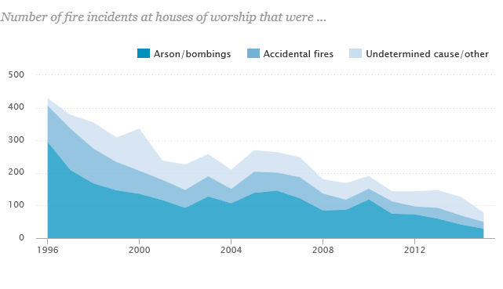
Statistics
Pew Research 1996-2015

Slide 14
Statistics
Church Mutual Insurance -2004
“Church Mutual insures more than 90,000 worship centers across the United States. For the past several years we’ve received about 2,100 claims a year for fire damage.”

Slide 15
Statistics
Top 5 Causes
Lightning
Electrical
Arson
Cooking accidents
Heating Systems

Slide 16
Styles of Houses of Worship
Traditional

Slide 18
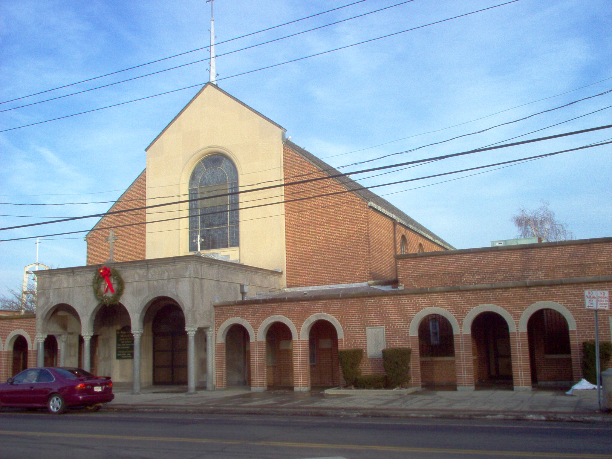

Slide 19
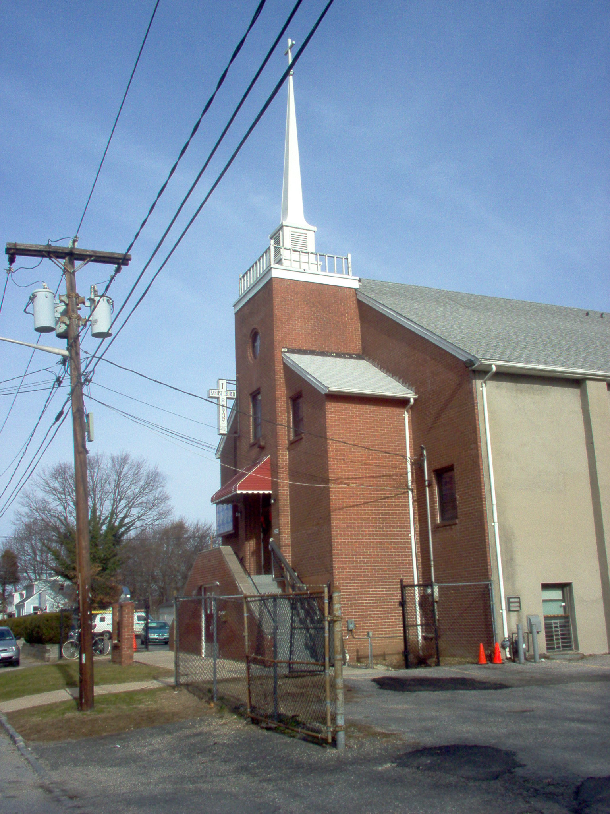

Slide 20
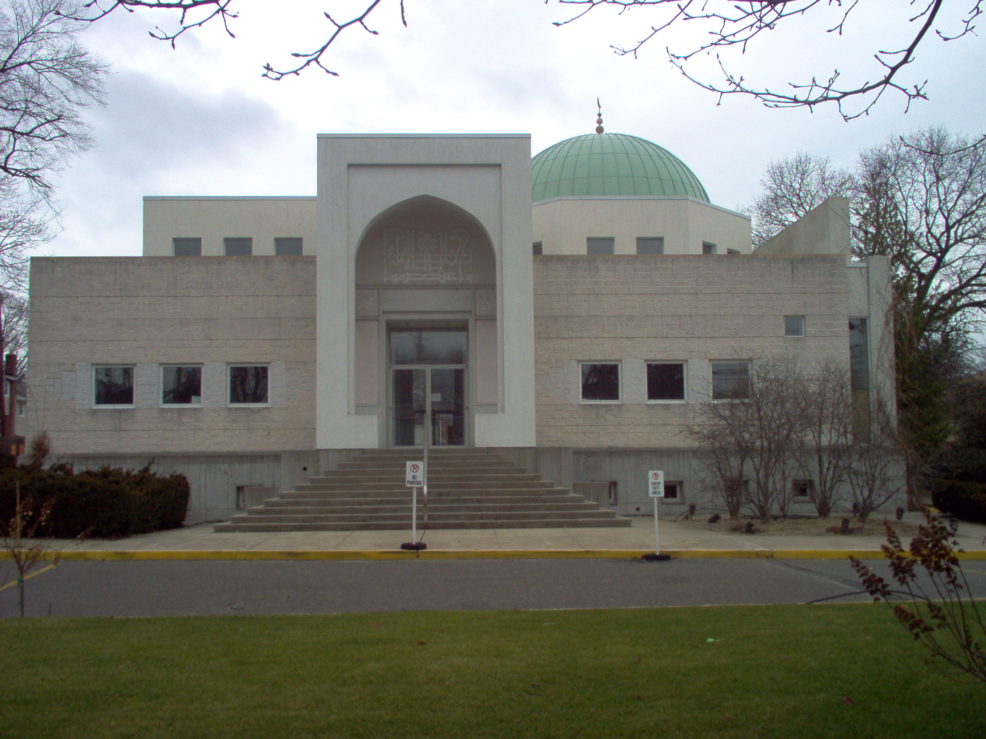

Slide 21
Styles of Houses of Worship
Traditional
Wood Frame

Slide 23
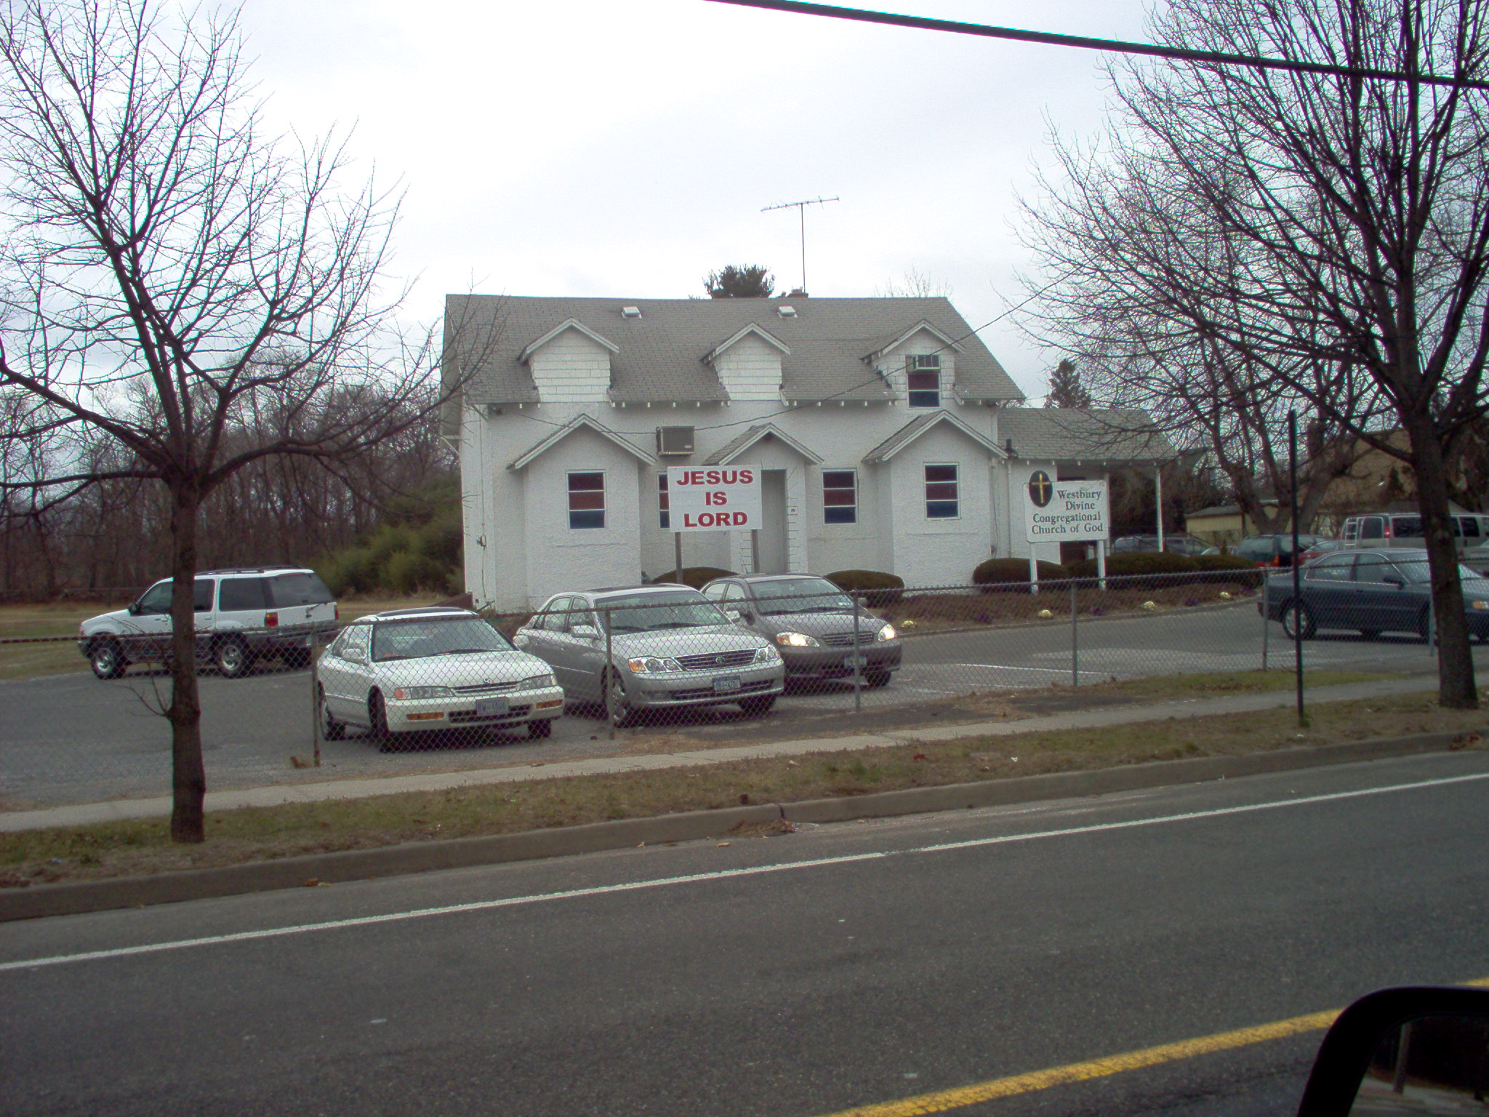

Slide 24
Styles of Houses of Worship
Traditional
Wood Frame
Modern

Slide 26
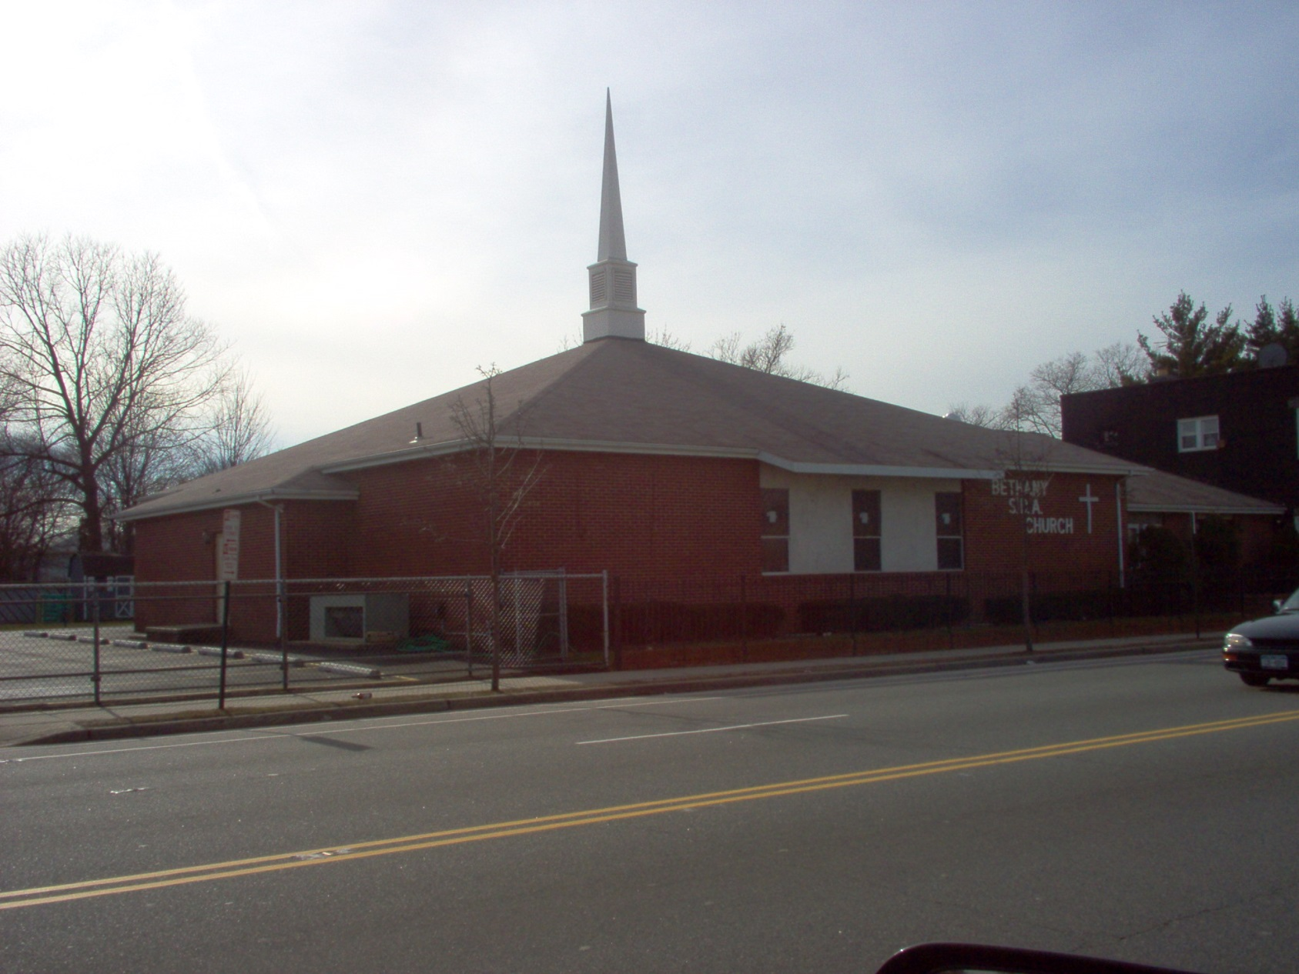

Slide 27
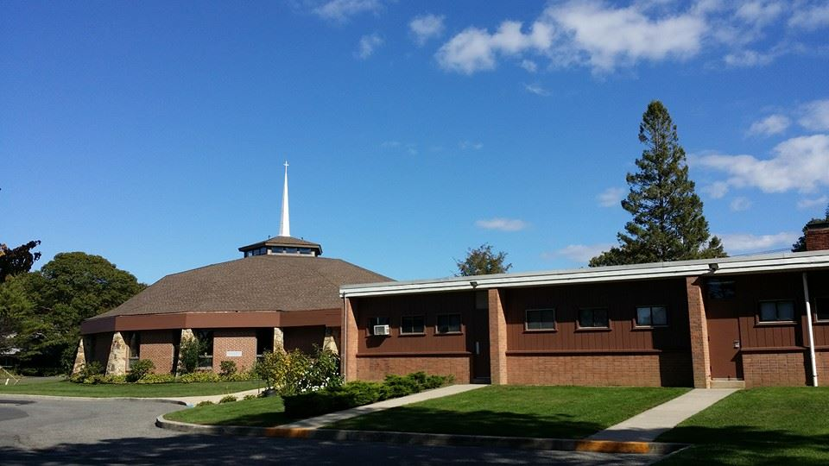

Slide 28
Styles of Houses of Worship
Traditional
Wood Frame
Modern
Store Front

Slide 33
Incident Priorities
Life Safety
A. Firefighter
B. Civilian
Incident Stabilization
Goal is to minimize the amount of damage or spread of the incident once FD intercedes

Slide 34
Incident Priorities
Property Conservation
A. Not just Salvage and Overhaul part of firefighting.
B. Can start with initial attack line
Stream Management
Aggressive Ventilation
Salvage covers/tarps
Committing necessary resources to protect contents

Slide 35
Incident Priorities
“Effective property conservation measures can have a positive impact on property owner and the community. Irreplaceable possessions can be saved, damage reduced, and the structure reoccupied within a minimum amount of time.”
Managing Company Tactical Operations: Strategy and Tactics Nassau County Vocational Education & Extension Board

Slide 36
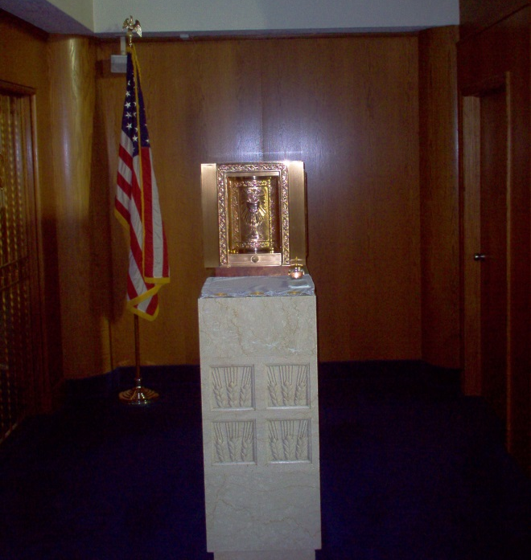
Possessions
Catholic and Orthodox Churches
1. Holy Scriptures
2. Tabernacle/
Antimis

Slide 37
Possessions
Protestant Churches
1. Holy Scriptures
2. Communion Ware

Slide 38
Possessions
Jewish Synagogue
1. Holy Scriptures- Torah/Scrolls

Slide 39
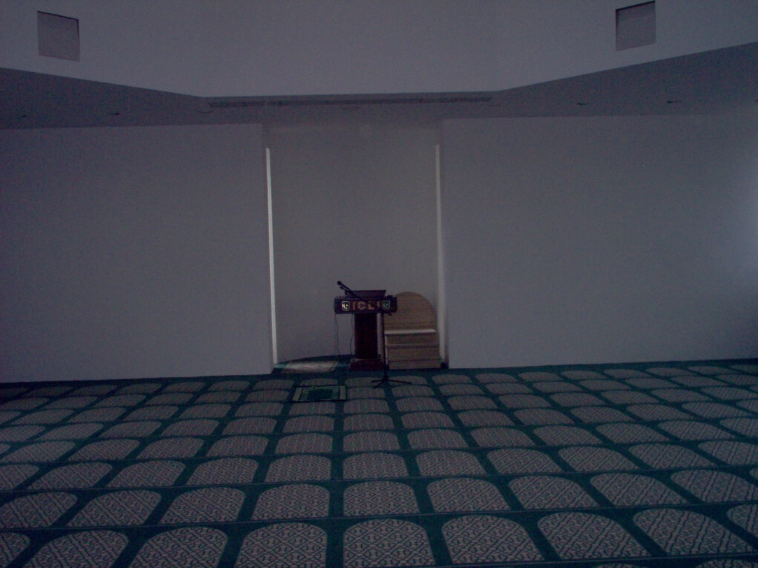
Possessions
Islam Temple
Koran
2. No sacred objects to save.

Slide 40
Possessions
Jehovah Witness
1. “It’s a place of prayer”
No sacred objects to save
2. Recently a style being built has no (or few) windows

Slide 41
Possessions
Mormon/Latter Day Saints
3 types of Houses
Ward houses
No sacred objects to save
Stake houses
No sacred objects to save
Family Life Centers
Genealogical materials

Slide 42
Possessions
Mormon/Latter Day Saints
Temple
Once initial open house is completed, very hard for non-Mormons to access.
Will have objects to save

Slide 43
Possessions
Buddhist Temple
1. Statue of Buddha

Slide 44
Possessions
Hindu Temple
1. Deities/Statues

Slide 45
Possessions
Hindu Temple
1. Deities/Statues
2. Murti – Statue of the founder/leader of temple

Slide 46
Possessions
Hindu Temple
1. Deities/Statues
2. Murti – Statue of the founder/leader of temple.
3. Hundi –Offering box.

Slide 47
Possessions
Hindu Temple
1. Deities/Statues
2. Murti – Statue of the founder/leader of temple.
3. Hundi –Offering box.
4. Tulsi – sacred plant

Slide 48
Other Considerations
Historical
Cemetery
Stained Glass Windows
a. Rosetta Window
Other Buildings
Official Records/Computers
Automatic Alarms
Language/Cultural Barriers
Crowd Control

Slide 49
Crowd Control Olean NY 8/28/2011

Slide 50
Preplan
The best advice is to take time to preplan your neighborhood Houses of Worship.
1. Learn style & setup of Building.
2. Find what to save and locations of items.
3. Build relations with local clergy.

Slide 51
Summary
What are the leading causes of House of Worship Fires?
Where are the leading areas of Fire Origin?
What are the four styles of Houses of Worship?
What are the possessions to save in a House of Worship Fire?

